Slide 1
DETECTION OF HEDONIC RESPONSE USING
BALLISTOCARDIOGRAPHY (BCG)
END Semester Presentation
Group members :
Praneel Rathore IIT2013034 Aayush Garg IIT2013061
Nipun Manocha IIT2013124
Under the guidance of :-
Prof. U.S. Tiwari

Slide 2
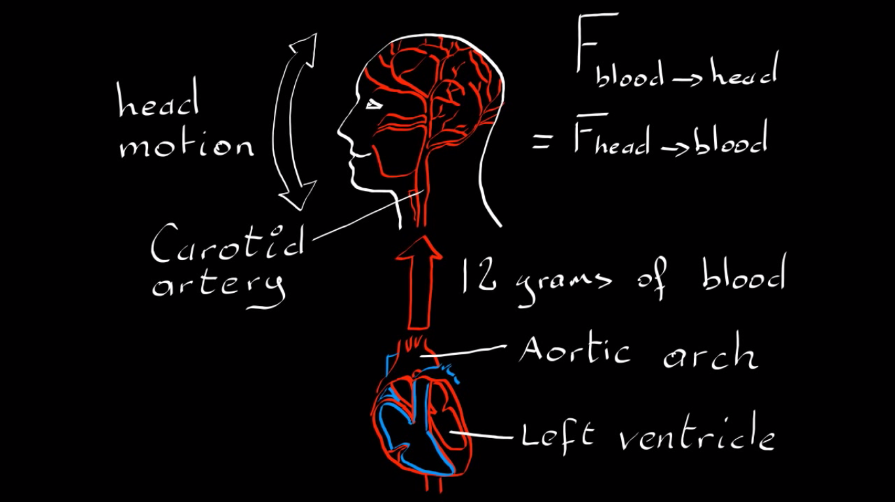

Slide 3
INTRODUCTION
BALLISTOCARDIOGRAPHY
In this project, we aim to exploit subtle head oscillations that accompany the cardiac cycle to extract information about cardiac activity from videos.
The cyclical movement of blood from the heart to the head causes the head to move in a periodic motion. Our algorithm detects pulse from this movement.
The ballistocardiograph (BCG) is a measure of ballistic forces on the heart. Ballistocardiography is a technique for producing a graphical representation of repetitive motions of the human body arising from the sudden ejection of blood into the great vessels with each heart beat.

Slide 4
PROBLEM
To develop a new technique which is to measure parameters associated with pulse rate (Heart Rate Variability) and in turn depicting change in emotions (positive/negative) using hedonic response.

Slide 5
PROJECT OBJECTIVES
To develop contact-less, cable less, non-invasive and simple technique to measure important heart related parameters, Pulse Rate and Heart Rate Variability.
The technique should record pulse rate and Heart Rate Variability using head vibrations in video.
With the help of this technique, we should be able to classify the mood/emotion of a subject as positive or negative.
Positive = {fun, exciting, joy, happy, cheerful}
Negative = {sad, depressing, hate, sentimental, melancholy}

Slide 6
TECHNOLOGY USED
Python 2.7
OpenCV 2.4.10
Scipy 0.18.1
Numpy 1.11.2
Matplotlib 1.5.3
PeakUtils 1.0.3

Slide 7
METHODOLOGY

Slide 8
Face Classifier
Video
Get Focused Area

Slide 9
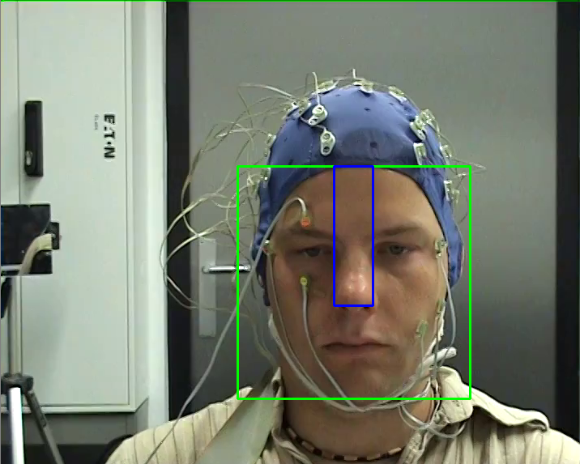
Face Classifier
Video
Get Focused Area

Slide 10
Face Classifier
Video
Get Focused Area
Select Corner Points (Features to track)

Slide 11
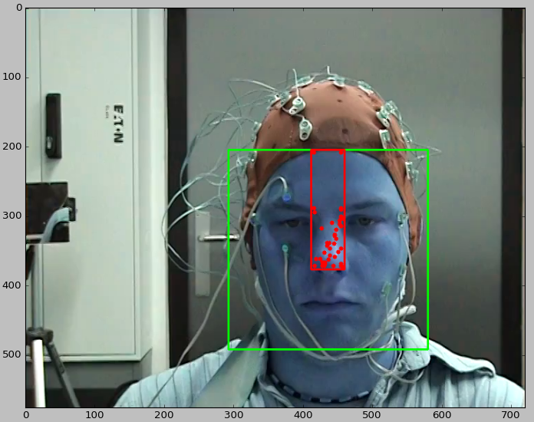
Face Classifier
Video
Get Focused Area
Select Corner Points (Features to track)

Slide 12
Face Classifier
Video
Get Focused Area
Select Corner Points (Features to track)
Track Features (Lucas Kanade)

Slide 13
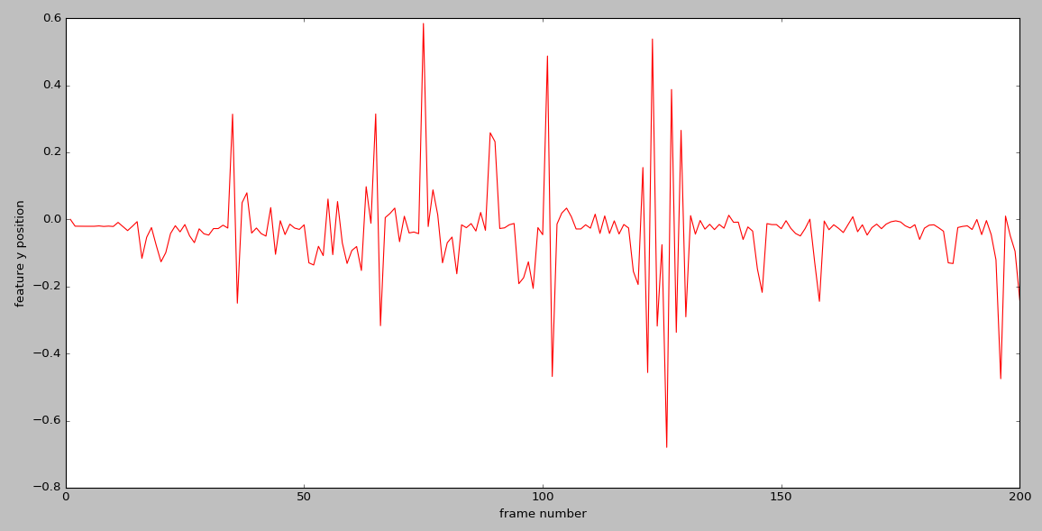
Face Classifier
Video
Get Focused Area
Select Corner Points (Features to track)
Track Features (Lucas Kanade)

Slide 14
Face Classifier
Video
Get Focused Area
Cubic Spline Interpolation
Select Corner Points (Features to track)
Track Features (Lucas Kanade)

Slide 15
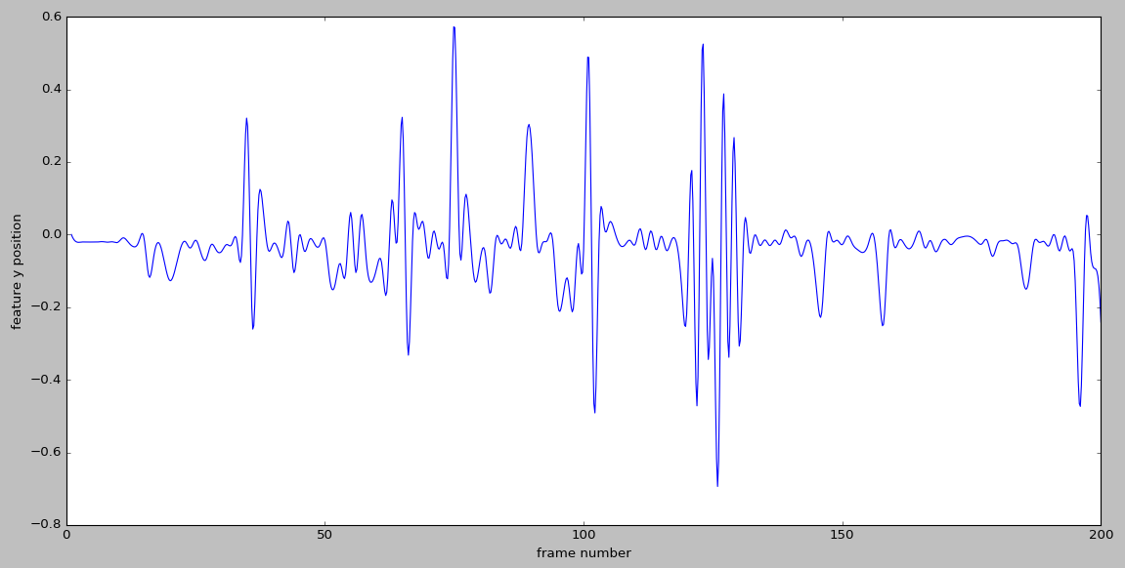
Face Classifier
Video
Get Focused Area
Cubic Spline Interpolation
Select Corner Points (Features to track)
Track Features (Lucas Kanade)

Slide 16
Butterworth Bandpass Filter
(0.75, 5) Hz
Face Classifier
Video
Get Focused Area
Cubic Spline Interpolation
Select Corner Points (Features to track)
Track Features (Lucas Kanade)

Slide 17
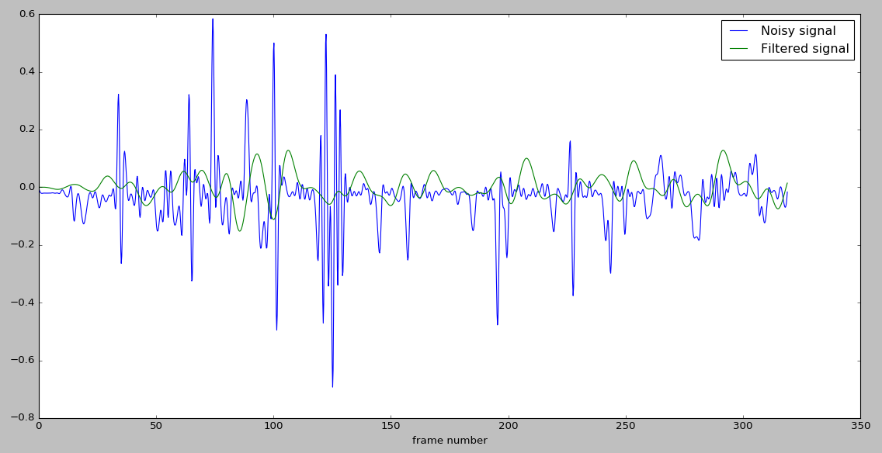
Butterworth Bandpass Filter
(0.75, 5) Hz
Face Classifier
Video
Get Focused Area
Cubic Spline Interpolation
Select Corner Points (Features to track)
Track Features (Lucas Kanade)

Slide 18
Butterworth Bandpass Filter
(0.75, 5) Hz
Face Classifier
PCA to select the best component
Video
Get Focused Area
Cubic Spline Interpolation
Select Corner Points (Features to track)
Track Features (Lucas Kanade)

Slide 19
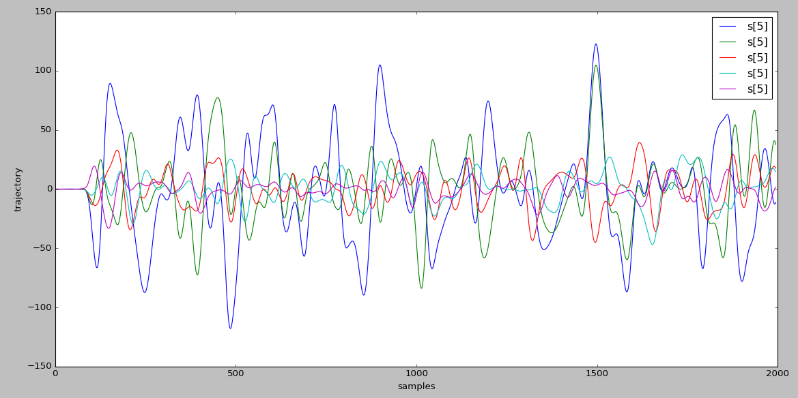
Butterworth Bandpass Filter
(0.75, 5) Hz
Face Classifier
PCA to select the best component
Video
Get Focused Area
Cubic Spline Interpolation
Select Corner Points (Features to track)
Track Features (Lucas Kanade)

Slide 20
We quantify a signal’s periodicity as the percentage of total spectral power accounted for by the frequency with maximal power and its first harmonic. And thus select the most periodic signal.

Slide 21
Butterworth Bandpass Filter
(0.75, 5) Hz
Face Classifier
PCA to select the best component
Video
Get Focused Area
Cubic Spline Interpolation
Detect Peaks in Curve
Select Corner Points (Features to track)
Track Features (Lucas Kanade)

Slide 22
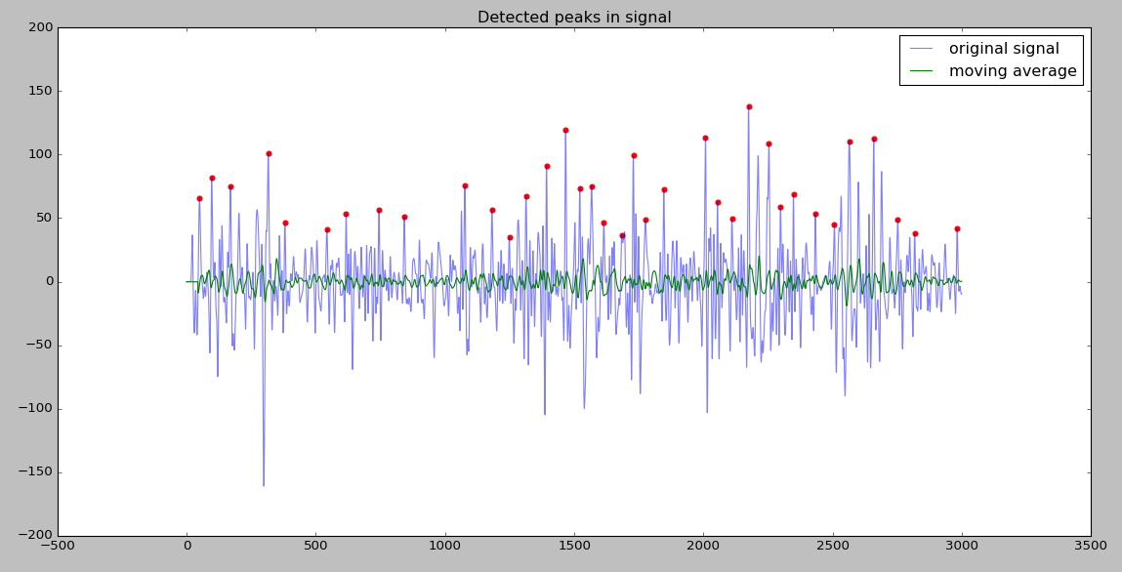
Butterworth Bandpass Filter
(0.75, 5) Hz
Face Classifier
PCA to select the best component
Video
Get Focused Area
Cubic Spline Interpolation
Detect Peaks in Curve
Select Corner Points (Features to track)
Track Features (Lucas Kanade)

Slide 23
Butterworth Bandpass Filter
(0.75, 5) Hz
Face Classifier
PCA to select the best component
Video
Get Focused Area
Cubic Spline Interpolation
Detect Peaks in Curve
Compute BPM
Select Corner Points (Features to track)
Track Features (Lucas Kanade)

Slide 24
pulseRate = 60 * fs / mean(RR_intervals)
fs = sampling frequency
fpulse = max freq of the chosen signal
RR_intervals = [consc. detected peak distances]

Slide 25
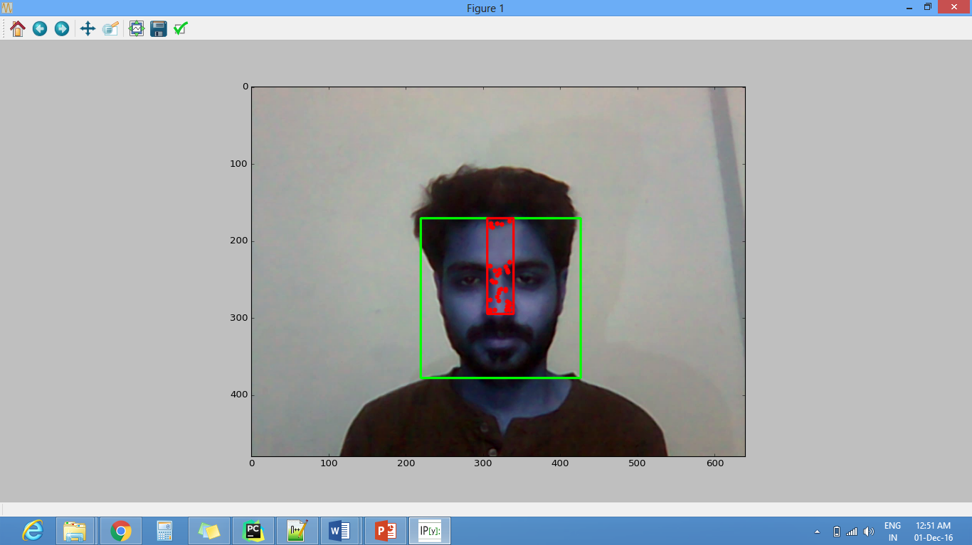
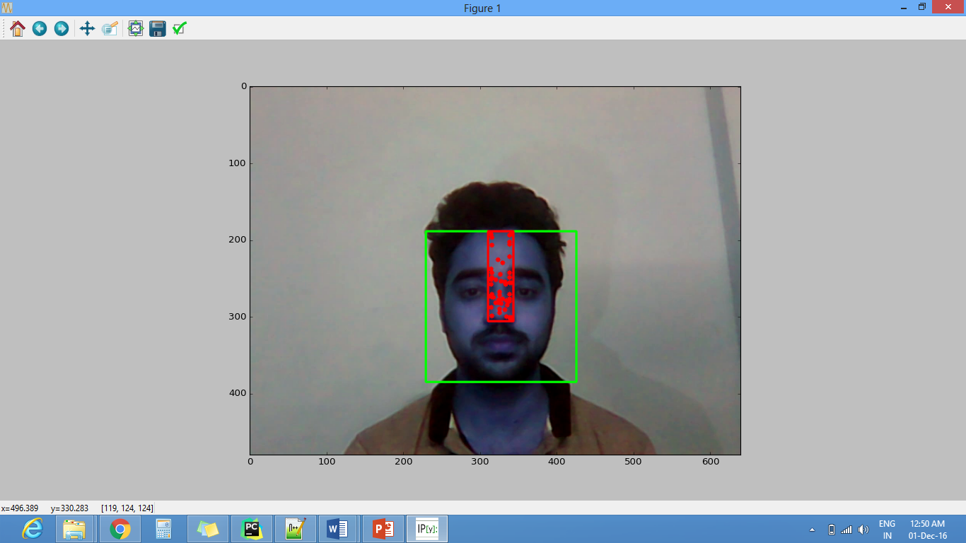
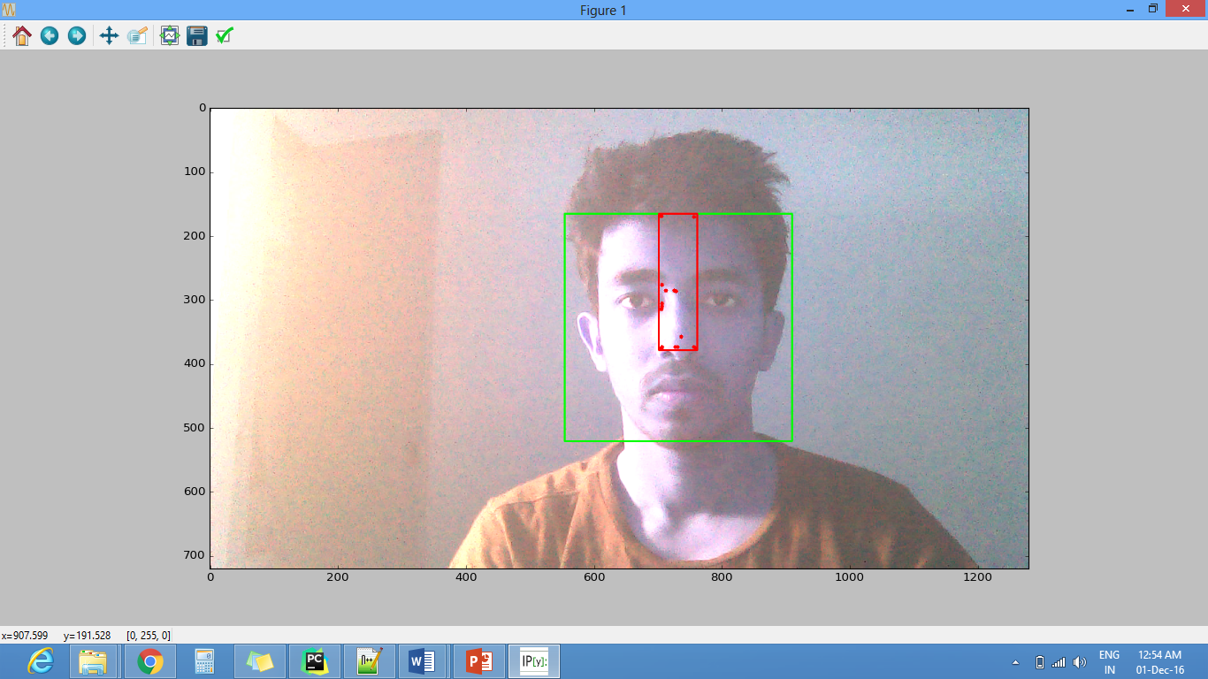
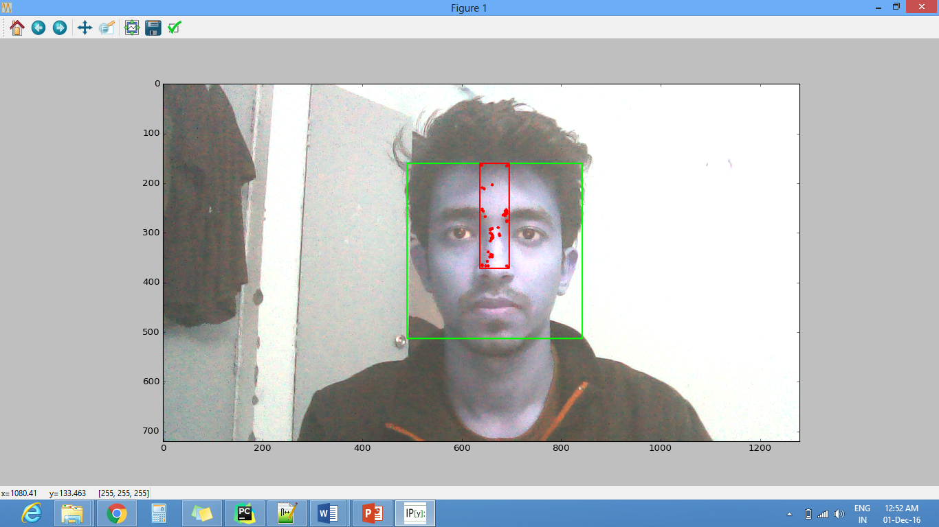
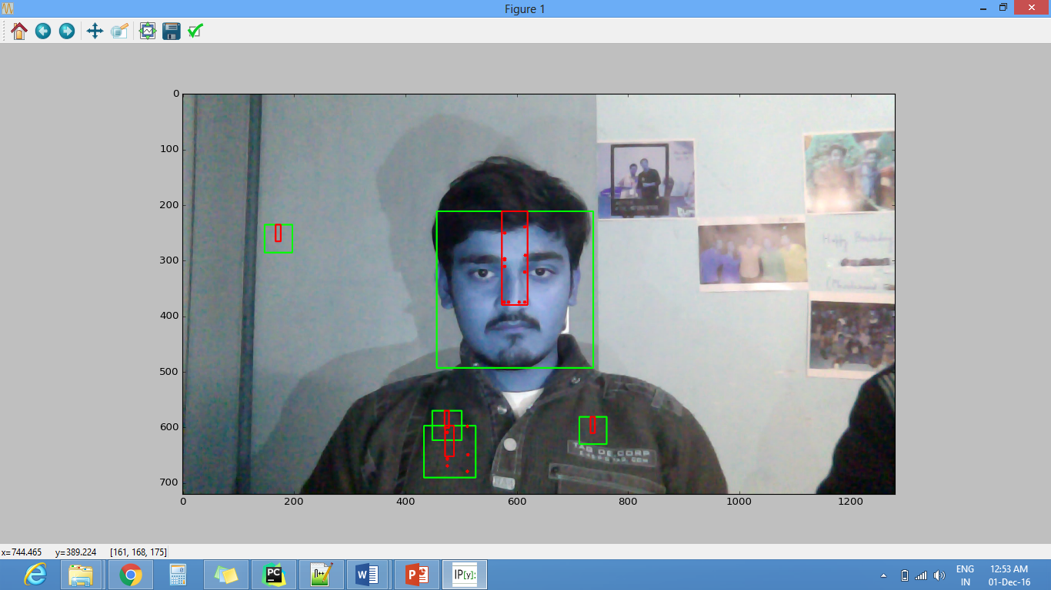
VERIFICATION OF PULSE RATE FINDINGS
Tested on self recorded videos
Calculated BPM from our algorithm was verified with the results of MI band that the subject was wearing at the time of recording.

Slide 26

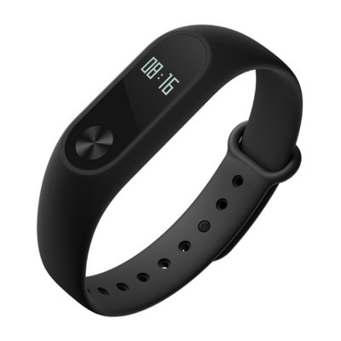
VERIFICATION OF PULSE RATE FINDINGS
Tested on self recorded videos
Calculated BPM from our algorithm was verified with the results of MI band that the subject was wearing at the time of recording.
71 BPM, 73 BPM, 75 BPM, …

Slide 27
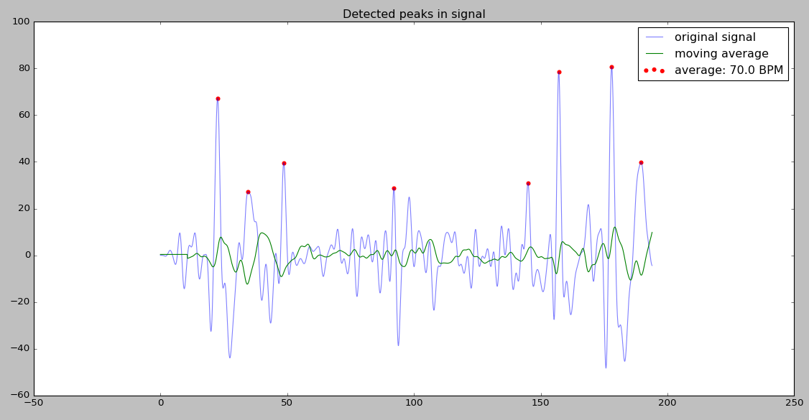
VERIFICATION OF PULSE RATE FINDINGS
Test 1
Tested on self recorded videos
Calculated BPM from our algorithm was verified with the results of MI band that the subject was wearing at the time of recording.

Slide 28
CALCULATION OF HRV
HRV = fs / samples in one RR_interval
HRV for peaks 1 and 2 = 0.984615, sample distance = 130.000000
HRV for peaks 2 and 3 = 0.941176, sample distance = 136.000000
HRV for peaks 3 and 4 = 0.955224, sample distance = 134.000000
HRV for peaks 4 and 5 = 1.000000, sample distance = 128.000000
HRV for peaks 5 and 6 = 1.024000, sample distance = 125.000000
…

Slide 30
We calculated HRVs for 11 subjects in the following moods –
POSITIVE – {fun, exciting, joy, happy, cheerful}
NEGATIVE = {sad, depressing, hate, sentimental, melancholy}

Slide 31
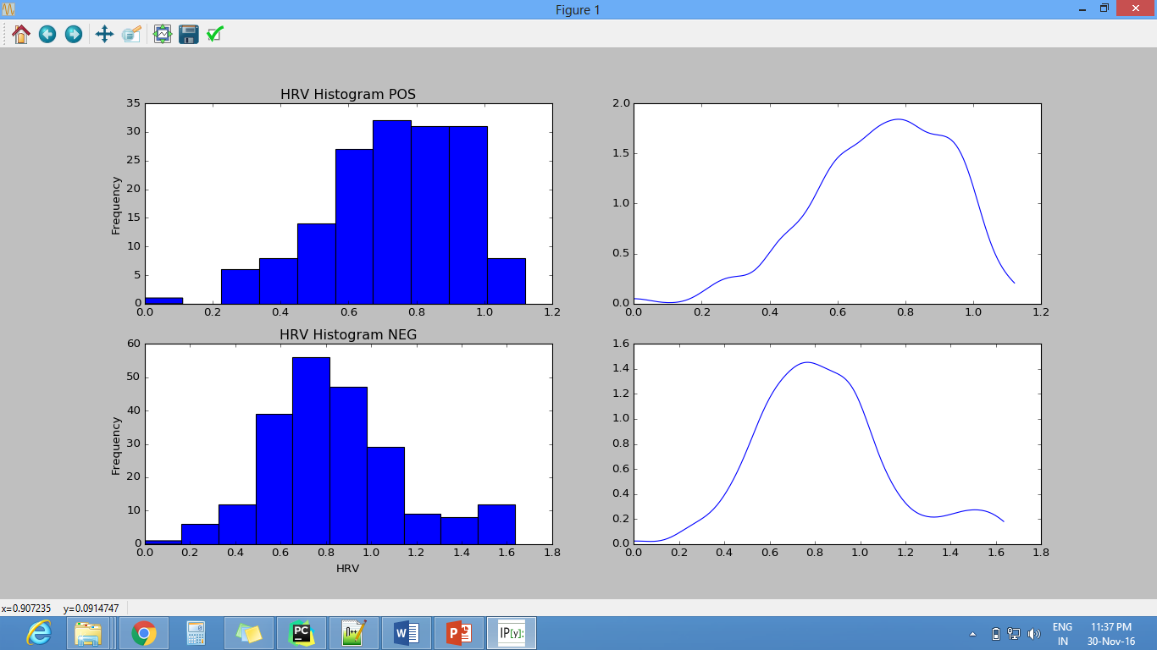
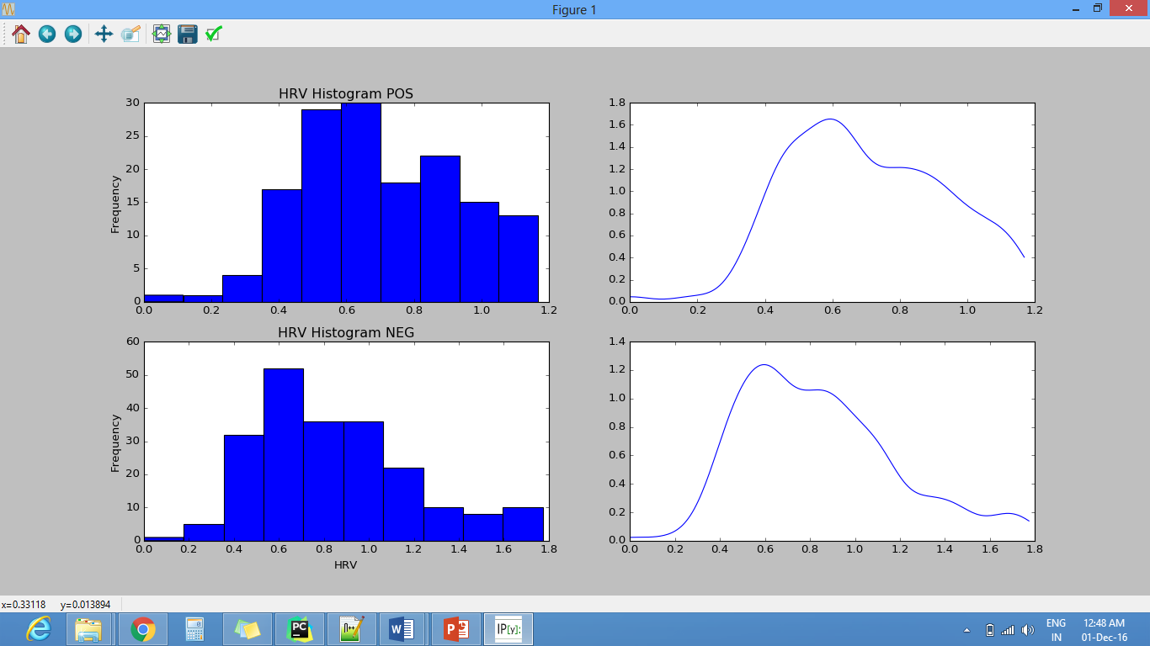
FOR ANY 02 SUBJECTS
Negative emotions – Relatively More Right Skewed, mean > median

Slide 32
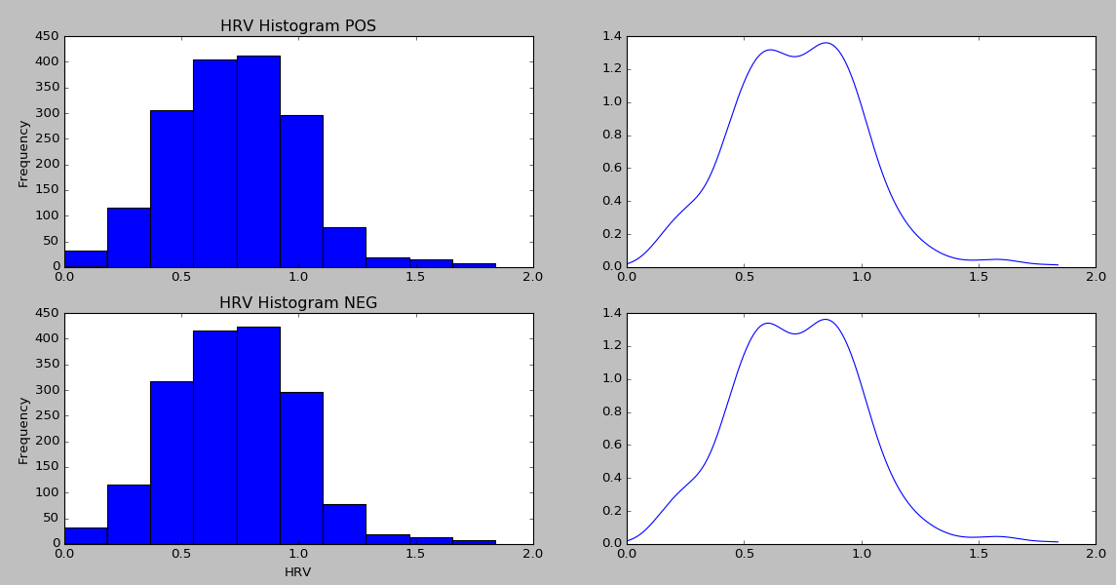
FOR ALL SUBJECTS COMBINED
Central Limit Theorem

Slide 33
Sub. No. | Statistical Measure | Positive 3.59, 8 |  |  |  |  | Negative 0, 6.65
01 | Area under the curve | 36.16 |  |  |  |  | 42.03
 | Standard Deviation | 0.26 |  |  |  |  | 0.255
 | Skewness | -0.314 |  |  |  |  | -0.208
 | Val Scale (Skewness) | 5.76 |  |  |  |  | 0.91
 | Area for intervals (0.3) | 0.14 | 0 | 5.4 | 9 | 9 | 0 | 0.98 | 6.25 | 9 |  | 9
02 | Area under the curve | 25.50 |  |  |  |  | 32.009
 | Standard Deviation | 0.282 |  |  |  |  | 0.287
 | Skewness | 0.012 |  |  |  |  | -0.027
 | Val Scale (Skewness) | 5.33 |  |  |  |  | 3.58
 | Area for intervals (0.3) | 0 | 0.62 | 5.44 | 9 | 9 | 0 | 0.86 | 4.84 | 9 |  | 9
03 | Area under the curve | 31.888 |  |  |  |  | 53.369
 | Standard Deviation | 0.231 |  |  |  |  | 0.345
 | Skewness | 0.0756 |  |  |  |  | 0.697
 | Val Scale (Skewness) | 4.79 |  |  |  |  | 3.76
 | Area for intervals (0.3) | 0 | 2.95 | 6.65 | 9 | 9 | 0 | 2.41 | 6.08 | 8.11 |  | 9
04 | Area under the curve | 47.587 |  |  |  |  | 56.433
 | Standard Deviation | 0.316 |  |  |  |  | 0.300
 | Skewness | 0.738 |  |  |  |  | 0.889
 | Val Scale (Skewness) | 3.59 |  |  |  |  | 0.0
 | Area for intervals (0.3) | 3.55 | 0 | 7.34 | 8.41 | 9 | 2.96 | 0 | 7.70 | 8.53 |  | 9
05 | Area under the curve | 22.725 |  |  |  |  | 27.435
 | Standard Deviation | 0.363 |  |  |  |  | 0.343
 | Skewness | 1.046 |  |  |  |  | 1.081
 | Val Scale (Skewness) | 5.4 |  |  |  |  | 6.65
 | Area for intervals (0.3) | 0.24 | 0 | 8.27 | 9 | 8.51 | 0 | 0.55 | 8.44 | 9 | 8.63

Slide 34
Pos
Neg
Negative emotions – Relatively More Right Skewed, mean > median

Slide 35
Thank you
Group members :
Praneel Rathore IIT2013034 Aayush Garg IIT2013061
Nipun Manocha IIT2013124

